Slide 1
专业外语
软件工程 物联网
2023-4-1

Slide 2
PART 2 INTERNET APPLICATIONS CHAPTER 4 TRADITIONAL INTERNET APPLICATIONS 4.1 OVERVIEW OF WORLD WIDE WEB(WWW)

Slide 3
KEYWORDS
WWW (Word Wide Web) 万维网，环球信息网
HyperText 超文本
client 客户
browser 浏览器
search 搜索
access 访问
download 下载

Slide 4
server 服务器
protocol 协议
HTTP (Hyper-Text Transfer Protocol)
超文本传输协议
web page 网页
URL (Uniform Resource Locator)
统一资源定位符（地址）
search engine 搜索引擎
search criteria 搜索条件

Slide 5
ISP (Internet Service Provider)
因特网服务提供商
path 通路，路径
AOL (America On Line) 美国在线
explore 探索
surf 冲浪
personal Web site 个人网站
register 注册
host 宿主机，主机

Slide 6
4.1.1 ABOUT WWW
WWW or Web is a large network of Internet servers providing hypertext and other services to terminals running client applications such as a browser.
WWW enables users to search, access, and download information from a worldwide series of networked servers where information is dynamically interlinked.

Slide 7
A Web client passes a user’s request for information to a server, usually by way of a Web browser.
The server and client communicate through a transfer protocol, usually the HypeText Transfer Protocol (HTTP).
The server then accesses a Web page using a Uniform Resource Locator (URL).
Search engines are available to simplify access by enabling users to enter search criteria on a topic and have several URLs returned for Web pages that pertain to the desired information.

Slide 8
1. Providers
The most common way to access the Internet is through an Internet service provider (ISP).
The providers are already connected to the Internet and provide a path or connection for individuals to access the Internet.
Your college or university most likely provides you with free access to the Internet either through its local area networks or through a dial-up or telephone connection.

Slide 9
There are also some companies that offer free Internet access.
The most widely used commercial Internet service providers are national providers (e.g. America Online (AOL)) and wireless providers.

Slide 10
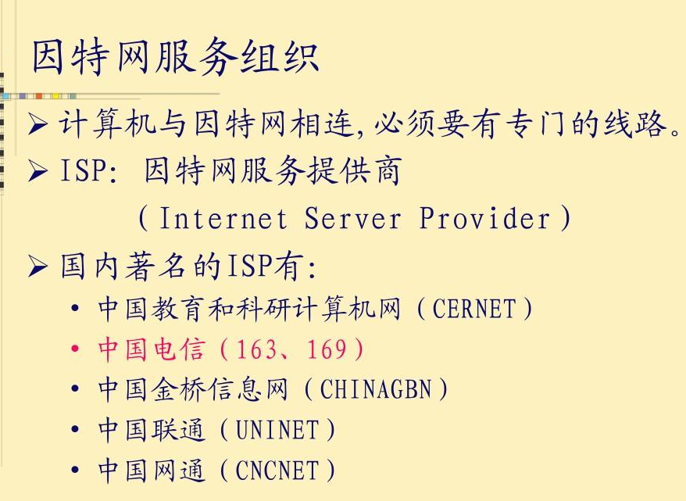

Slide 11
2. Browsers
Browsers are programs that provide access to Web resources.
This software connects you to remote computers, opens and transfers files, displays text and images, and provides in one tool an uncomplicated interface to the Internet and Web documents.

Slide 12
Browsers allow you to explore, or to surf the Web by easily moving from one Web site to another.
Three well-known browsers are Mozilla Firefox, Netscape Communications, and Microsoft Internet Explorer. (See Figure 4-1.)

Slide 13
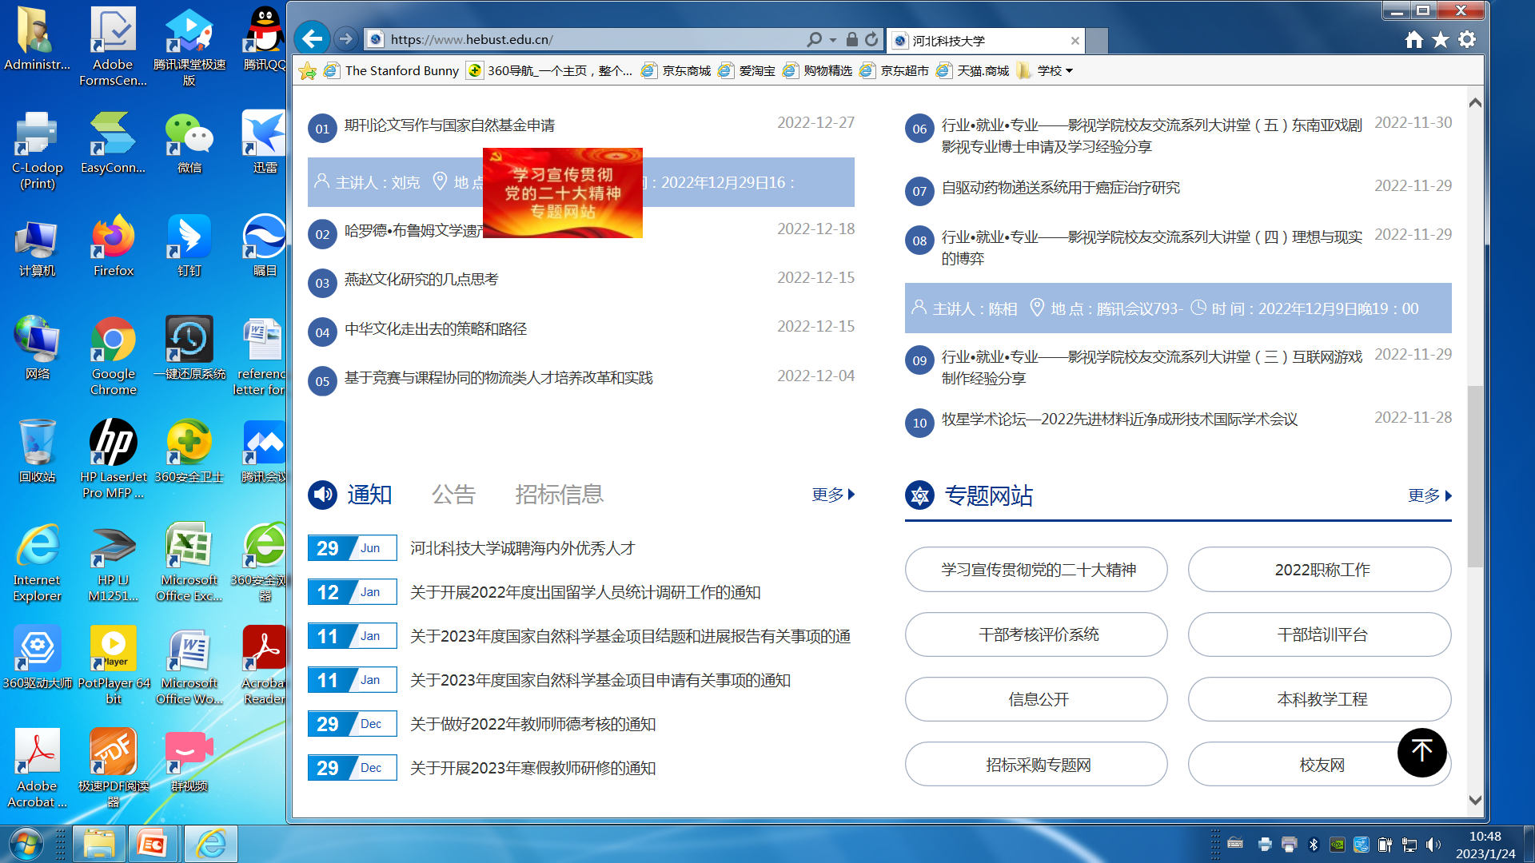
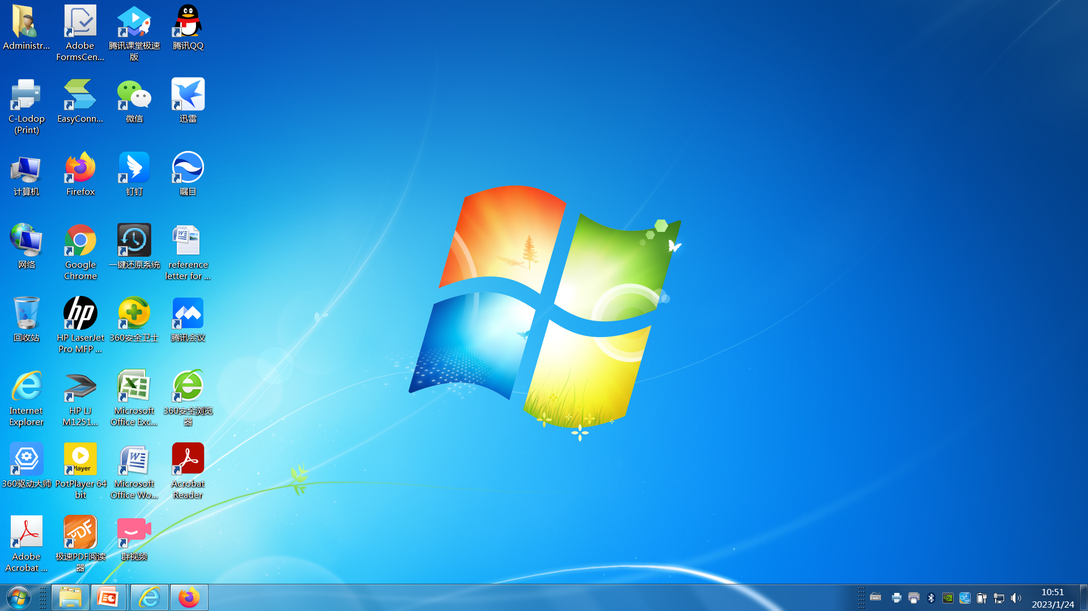
Figure 4-1 Internet Explorer

Slide 14
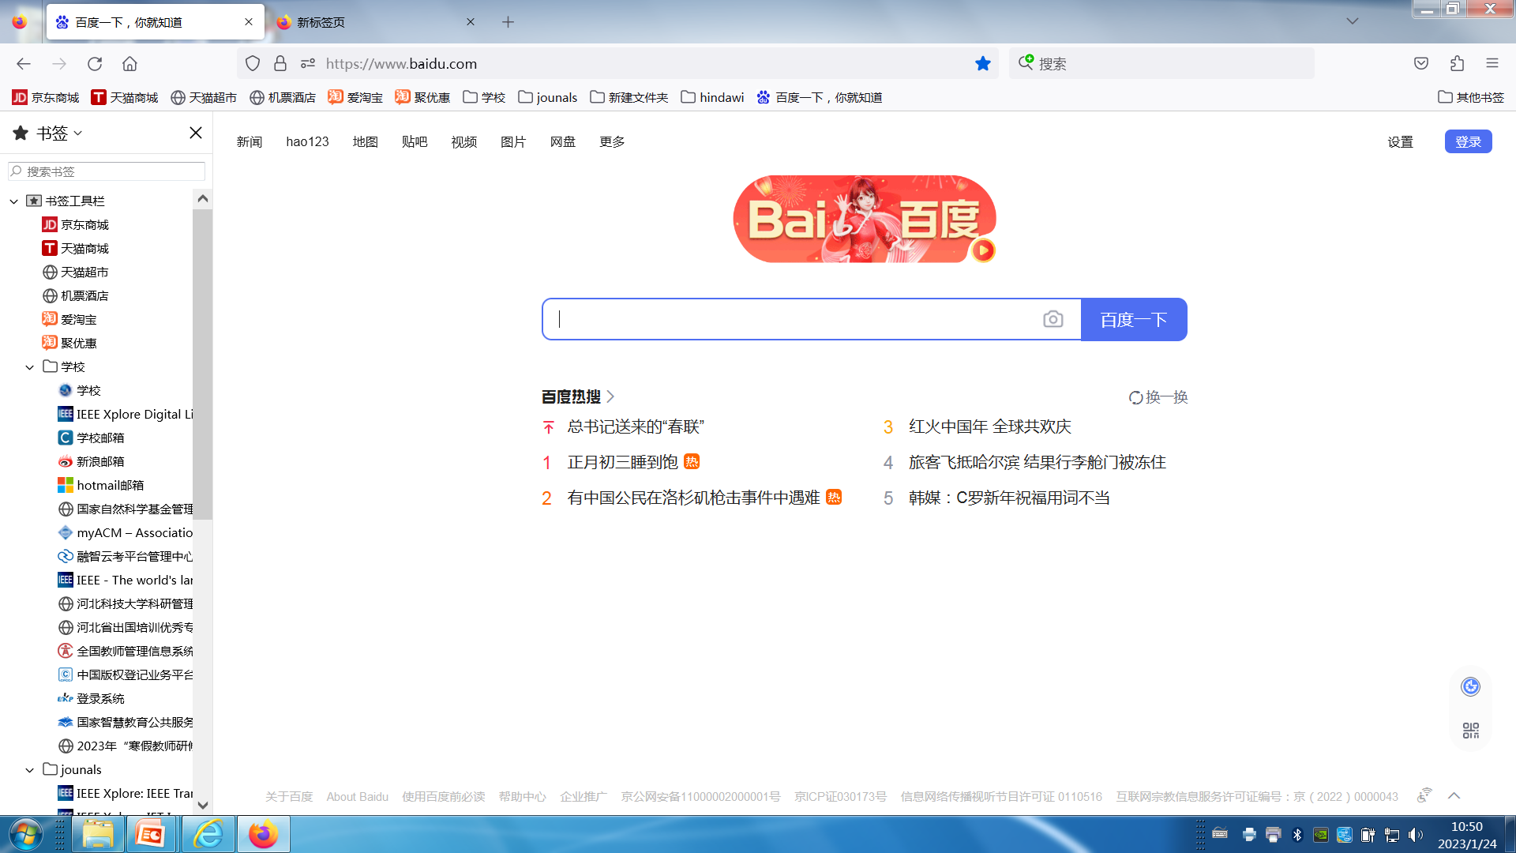
Firefox

Slide 15
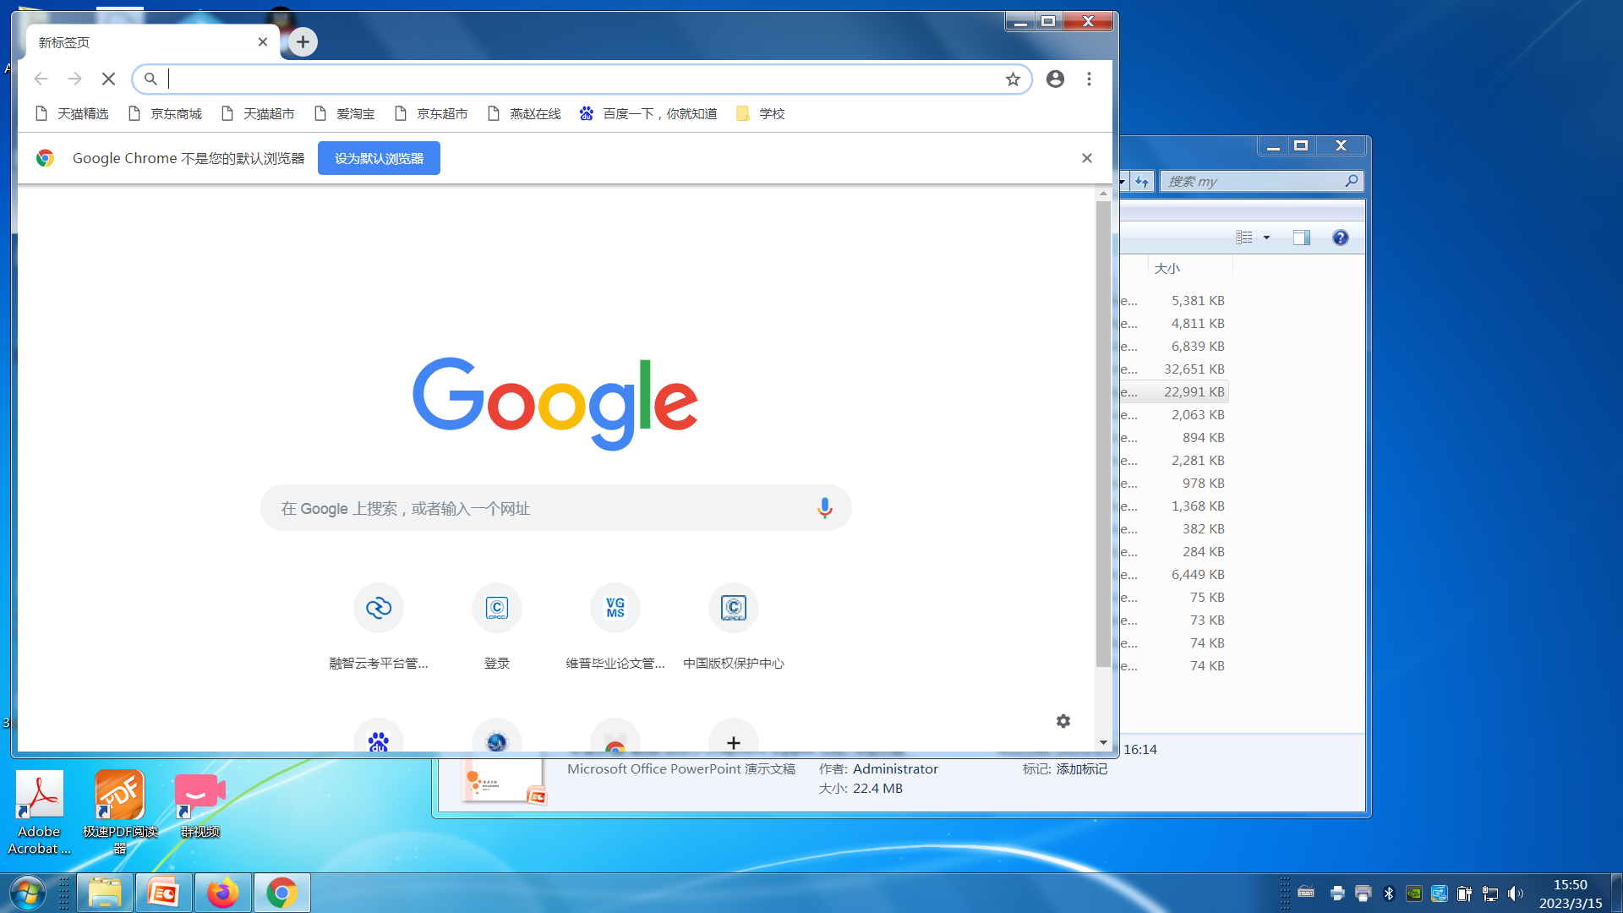
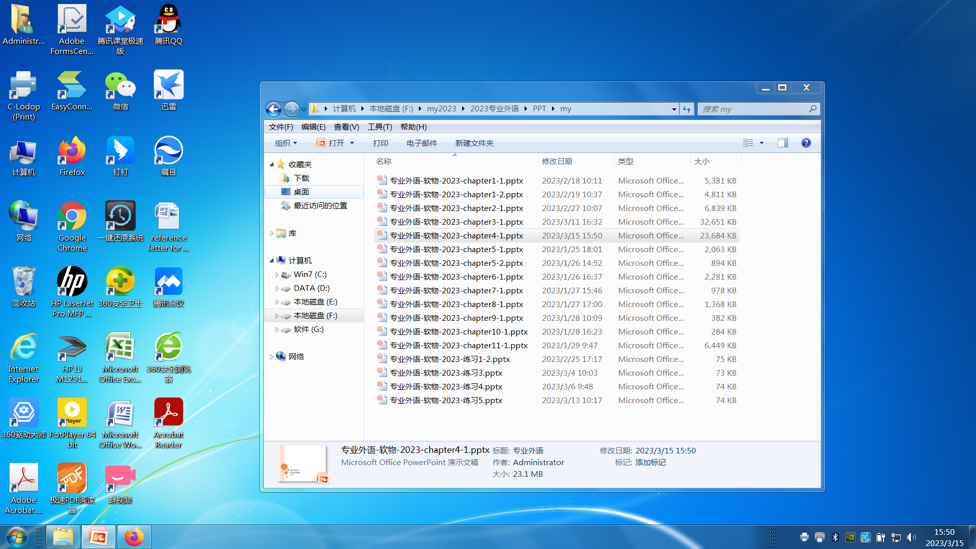

Slide 16
Browser is a GUI-based hypertext client application, used to access hypertext documents and other services located on innumerable remote servers throughout the WWW and Internet.
As you see from Figure 4-2, what goes on when you click a hyperlink is a pretty significant series of events, involving not only your Web browser software, but also a Web server somewhere, and the transactions involved rely heavily on the HTML language.

Slide 17
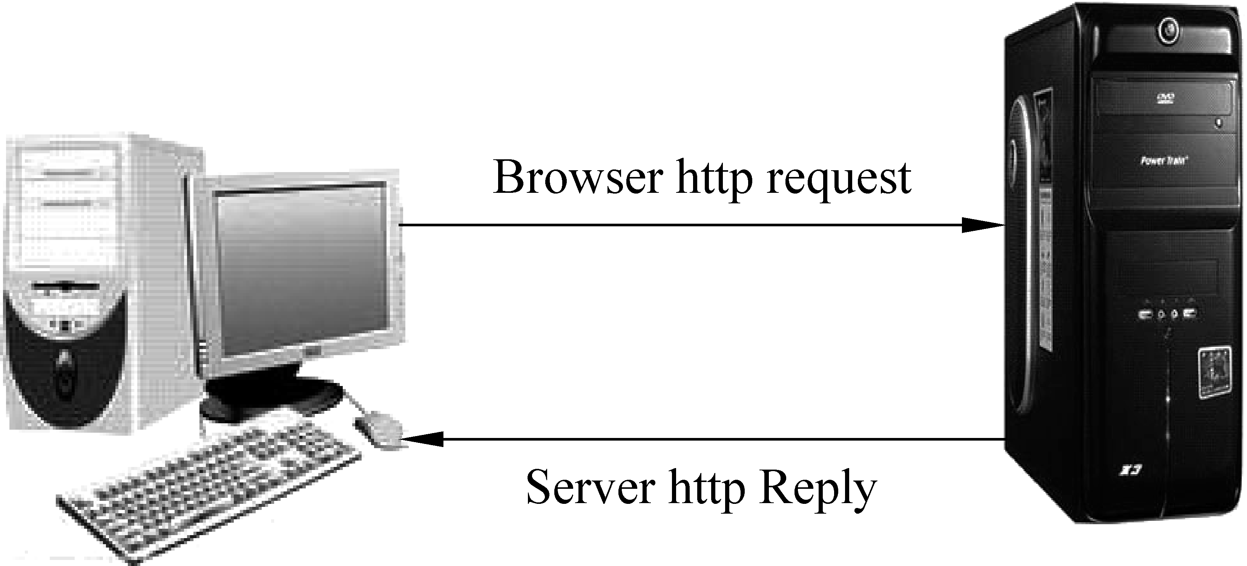
Figure 4-2 Web browser/server communication

Slide 18
3. Personal Web
Do you have something to share with the world?
Would you like a personal Web site, but don’t want to deal with learning HTML?
Creating your own home on the Internet is easy, and there are many services available to get you started.

Slide 19
A service site on the Web provides access to tools to create personal Web pages.
After registering with the site, you create your Web pages using the tools provided.
Once completed, the service site acts as a host for your personal Web site and others are free to visit it from anywhere in the world.

Slide 20
4.1.2 SEARCH ENGINES

Slide 21
KEYWORDS
search tool 搜索工具
spider 网络蜘蛛，万维网查询工具
index 索引
index database 索引数据库
cache 高速缓存
query 查询
key word 关键字
crawler 爬行者，浏览器

Slide 22
1. Overview
Imagine walking into a library where books are piled up and strewn about without any order.
Finding what you are looking for would be next to impossible.
As the World Wide Web rapidly grew, it is necessary to categorize message of Web page and to keep track of “what’s what” and “what’s where”.
In the initial stages of the Web, it was hard to locate useful information.

Slide 23
In the early days of the World Wide Web, two graduate students at Stanford University, Jerry Yang and David Filo, came up with a way to organize hyperlinks by category and they found it useful.
In late 1993 this way was known as “Jerry Yang’s Guide to the WWW.”
The name was soon changed to Yahoo! and the first search tool was born.

Slide 24
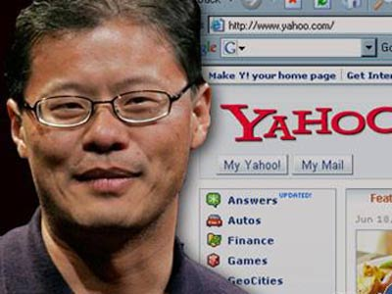
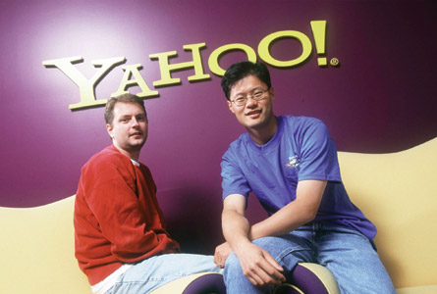
Jerry Yang 杨致远
Jerry Yang and David Filo
From the Internet

Slide 25
Today there is quite a collection of search tools available that allows us to find required information on the Web quickly and easily.
The collection of search tools is constantly evolving, with new ones coming on the scene and others disappearing.
Rather than report on how each of the popular search tools works, we will explain a few of them and suggest some Web presentations that provide reviews of all of the current search tools available.

Slide 26
2. How search engines work
A search engine operates, in the following order
(1) Web crawling
(2) Indexing
(3) Searching

Slide 27
Web search engines work by storing information about many web pages, which they retrieve from the html itself.
These pages are retrieved by a Web crawler (sometimes also known as a spider) — an automated Web browser which follows every link on the site.

Slide 28
The contents of each page are then analyzed to determine how it should be indexed (for example, words are extracted from the titles, headings, or special fields called meta tags).
Data about web pages are stored in an index database for use in later queries.

Slide 29
A query can be a single word.
The purpose of an index is to allow information to be found as quickly as possible.
Some search engines, such as Google, store all or part of the source page (referred to as a cache) as well as information about the web pages, whereas others, such as AltaVista, store every word of every page they find.

Slide 30
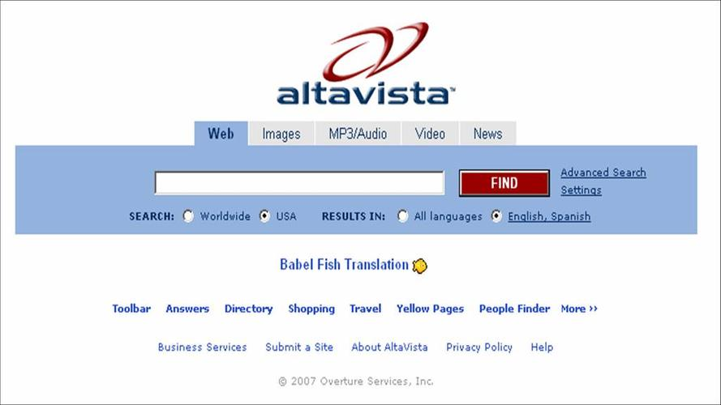

Slide 31
This cached page always holds the actual search text since it is the one that was actually indexed, so it can be very useful when the content of the current page has been updated and the search terms are no longer in it.

Slide 32
When a user enters a query into a search engine (typically by using key words), the engine examines its index and provides a listing of best-matching web pages according to its criteria, usually with a short summary containing the document’s title and sometimes parts of the text.

Slide 33
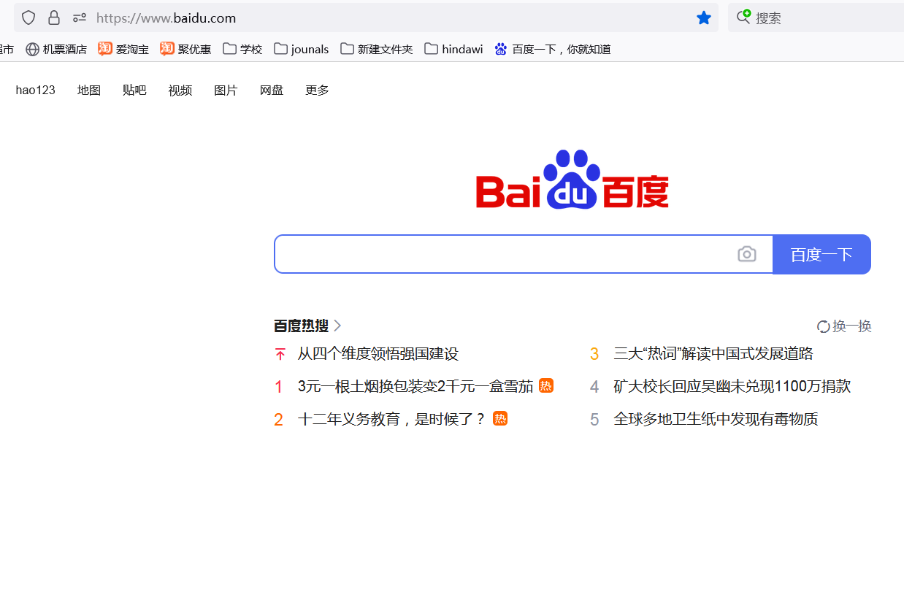

Slide 34
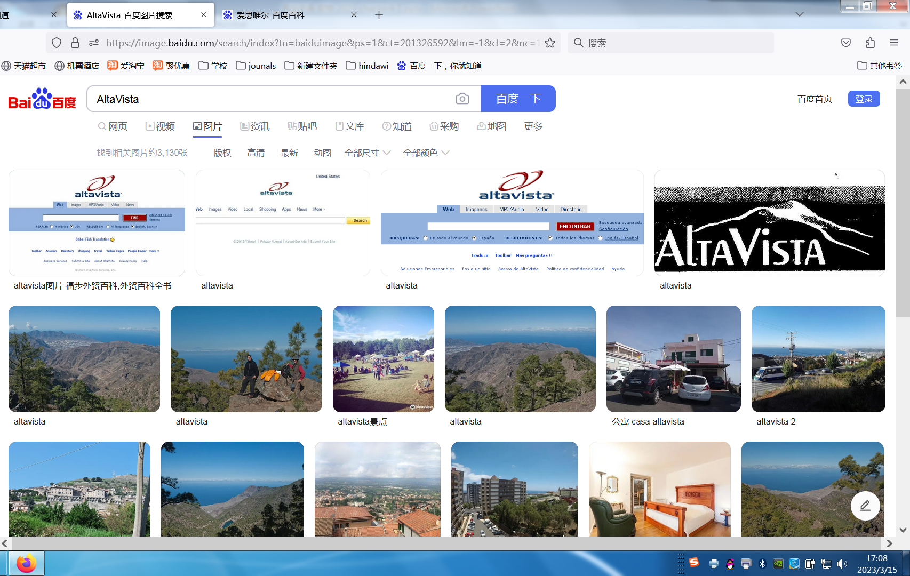

Slide 35
4.2 E-MAIL

Slide 36
KEYWORDS
E-mail 电子邮件
electronic message 电子消息（报文，电文）
attachment 附件
account 账户（号）
header 头部
signature 签名
address 地址
user’s name 用户名

Slide 37
domain name 域名
subject 主题
spam 垃圾邮件
mailing list 邮件地址表，邮件清单
spam blocker 垃圾邮件拦截器

Slide 38
E-mail or electronic mail is the transmission of electronic messages over the Internet.
At one time, e-mail consisted only of basic text messages.
Now e-mail routinely includes graphics, photos, and many different types of file attachments.

Slide 39
People all over the world send e-mail to each other.
You can e-mail your family, your co-workers.
All you need to send and receive e-mail is an e-mail account, access to the Internet, and an e-mail program.
Two of the most widely used e-mail programs are Microsoft’s Outlook Express and Mozilla Thunderbird.

Slide 40
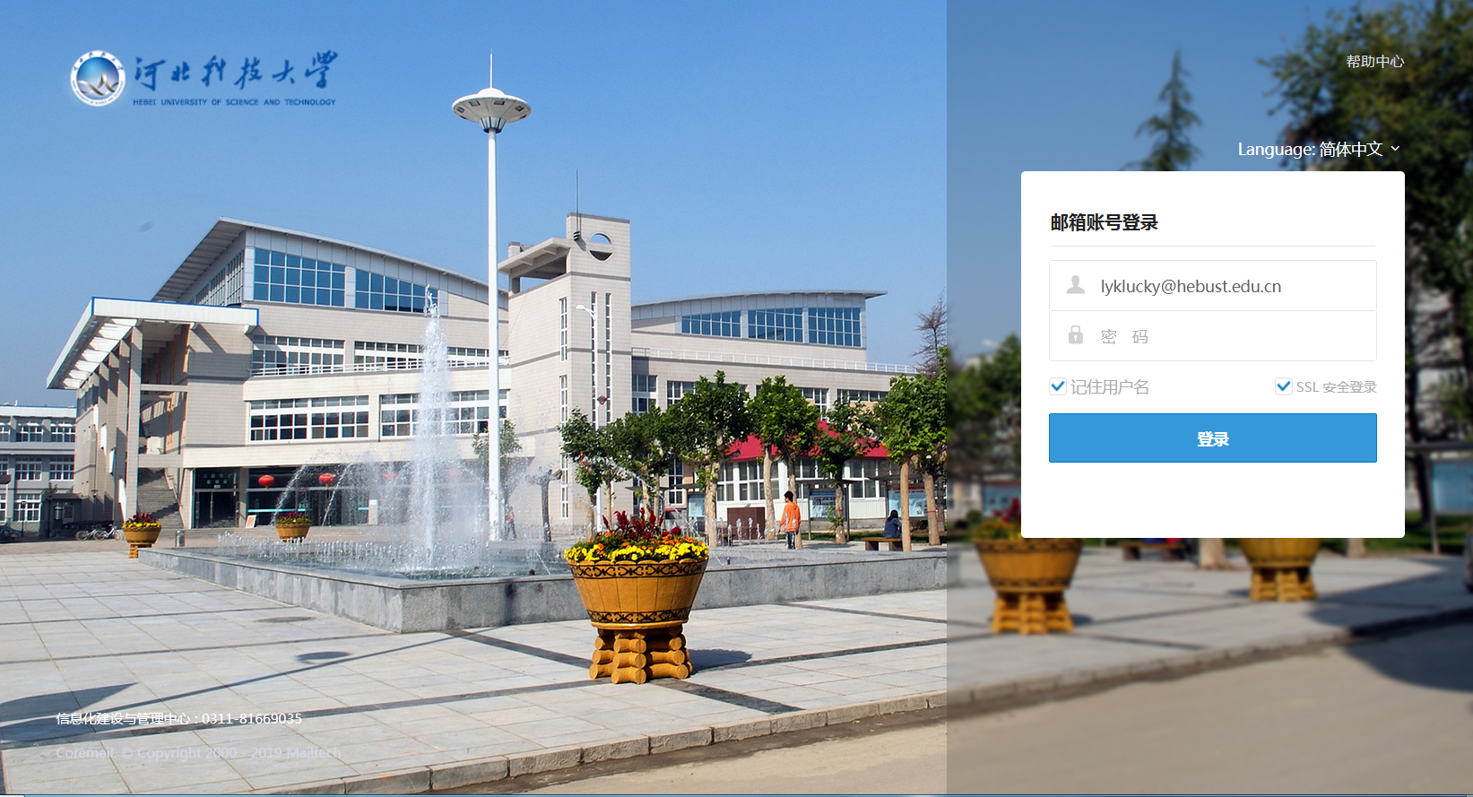

Slide 41
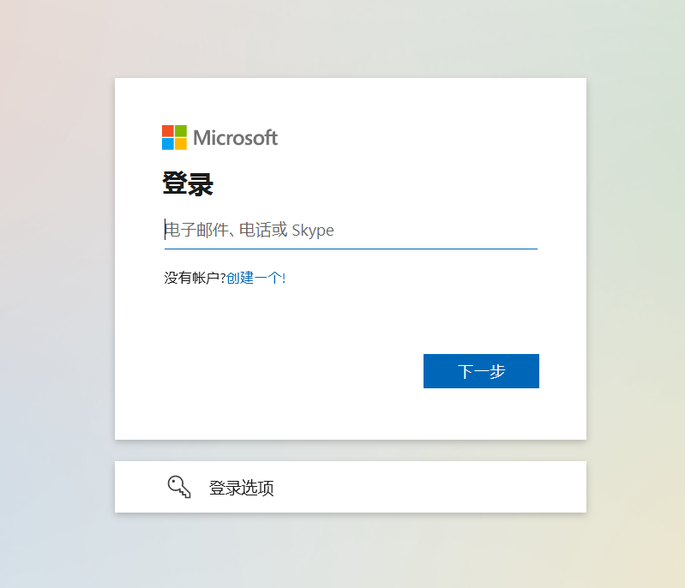

Slide 42
A typical e-mail message has three basic elements: header, message, and signature. (See Figure 4-3.)
The header appears first and typically includes the following information:
Figure 4-3 Basic elements of an E-mail message

Slide 43
(1) Addresses: Addresses of the persons sending, receiving, and, optionally, anyone else who is to receive copies. E-mail addresses have two basic parts. (See Figure 4-4.)
The first part is the user’s name and the second part is the domain name, which includes the top-level domain.

Slide 44
Figure 4-4 Two parts of an e-mail address
In our example e-mail, dcoats is Dan’s user name.
The server providing e-mail service for Dan is usc.edu.
The top-level domain indicates that the provider is an educational institution.

Slide 45
(2) Subject: A one-line description, used to present the topic of the message.
Subject lines typically are displayed when a person checks his or her mailbox.

Slide 46
(3) Attachments: Many e-mail programs allow you to attach files such as documents and worksheets.
If a message has an attachment, the file name appears on the attachment line.
The letter or message comes next.
It is typically short and to the point.
Finally, the signature line provides additional information about the sender. Typically, this information includes the sender’s name, address, and telephone number.

Slide 47
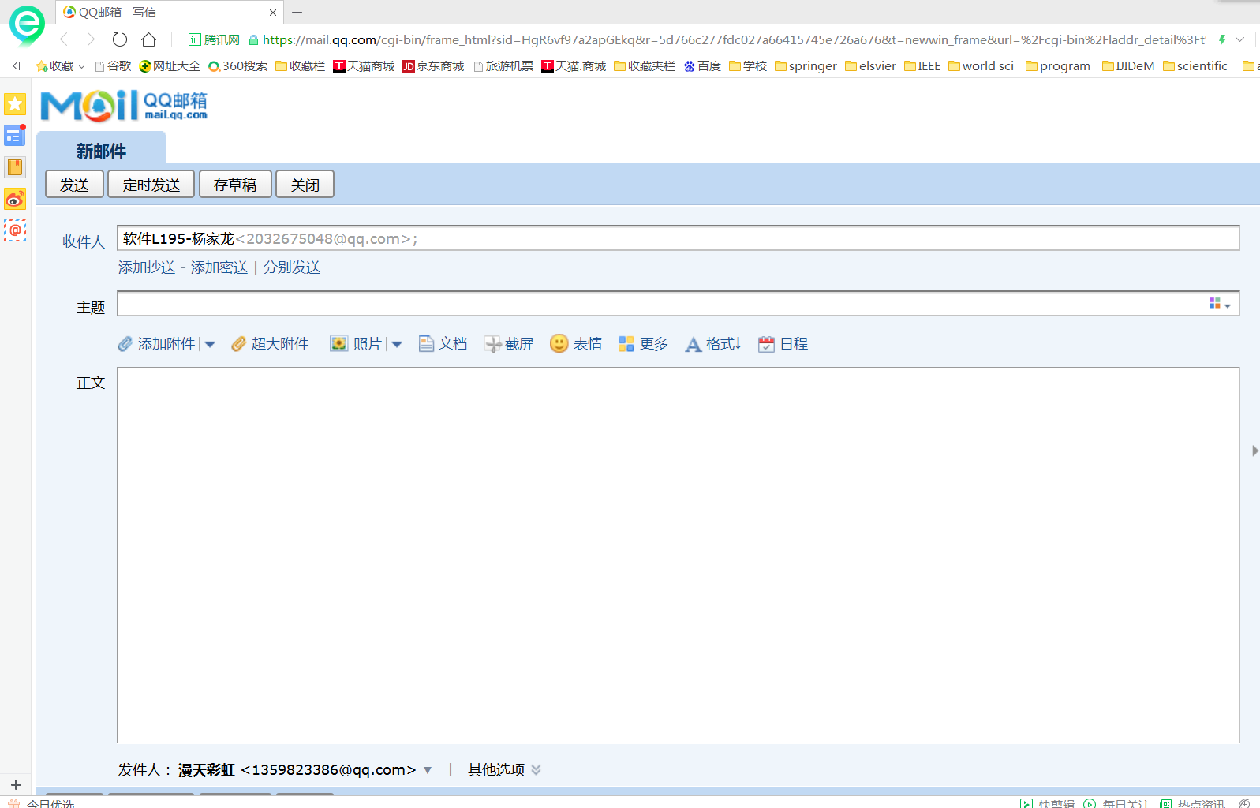

Slide 48
E-mail can be a valuable asset in your personal and professional life.
However, like many other valuable technologies, there are drawbacks too.
Americans receive billions of unwanted and unsolicited e-mails every year.
This unwelcome mail is called spam.

Slide 49
While spam is indeed a distraction and nuisance, it also can be dangerous.
For example, computer viruses or destructive programs are often attached to unsolicited e-mail.
In an attempt to control spam, anti-spam laws have been added to our legal system.
For example, the recently enacted CAN-SPAM Act requires that every marketing-related e-mail provide an opt-out option.

Slide 50
When the option is selected, the recipient’s e-mail address is to be removed from future mailing lists.
This approach, however, has had minimal impact since over 50 percent of all spam originates from servers outside the United States.
A more effective approach has been the development and use of spam blockers.(See Figure 4-5)
These programs use a variety of different approaches to identify and eliminate spam.

Slide 51
Figure 4-5 Spam blockers

Slide 52
4.3 ELECTRONIC COMMERCE AND THE INTERNET OF THINGS 4.3.1 ELECTRONIC COMMERCE

Slide 53
KEYWORDS
electronic commerce 电子商务
B2B(B to B, Business-to-Business) 商业对商业
business mode 企业模式，业务模式
B2C (Business-to-Consumer) 企业对消费者
C2C (Consumer-to-Consumer) 消费者对消费者
B2G (Business-to-Government) 企业对政府
P2P (Person-to-Person) 个人对个人
C2G (Customer-to-Government) 客户对政府

Slide 54
supply chain 供应链
click-and-mortar 混合经营的

Slide 55
1. What is Electronic Commerce
Electronic commerce is a system that includes not only those transactions that center on buying and selling goods and services to directly generate revenue, but also those transactions that support revenue generation, such as generating demand for those goods and services, offering sales support and customer service (see Figure 4-6), or facilitating communications between business partners.

Slide 56
Electronic commerce builds on the advantages and structures of traditional commerce by adding the flexibilities offered by electronic networks.

Slide 57
Electronic commerce enables new forms of business, as well as new ways of doing business.
Amazon.com, for example, is a bookseller based in Seattle, Washington.
The company has not physical stores, sells all their books via the Internet, and coordinates deliveries directly with the publishers so they do not have to maintain any inventory.
Companies such as Kantara and software.net take this a step further.

Slide 58
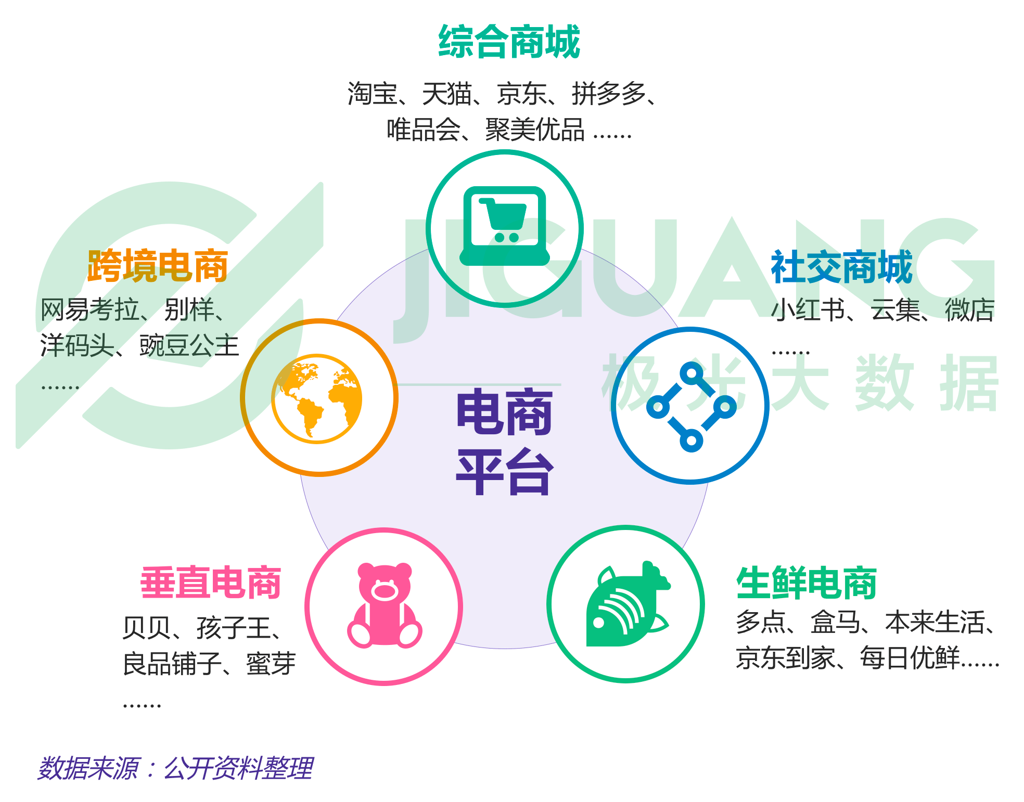
From the Internet

Slide 59
Because all of their products (commercial software packages) are electronic, and can be stored on the same computers that they use for processing orders and serving the Web, their inventory is totally digital.
As another example, AMP Inc. is offering its clients the opportunity to purchase electronic connectors and related components directly from its Web-based catalog, bypassing the need for EDI-based (Electronic Data Interchange) purchase orders and confirmations.

Slide 60
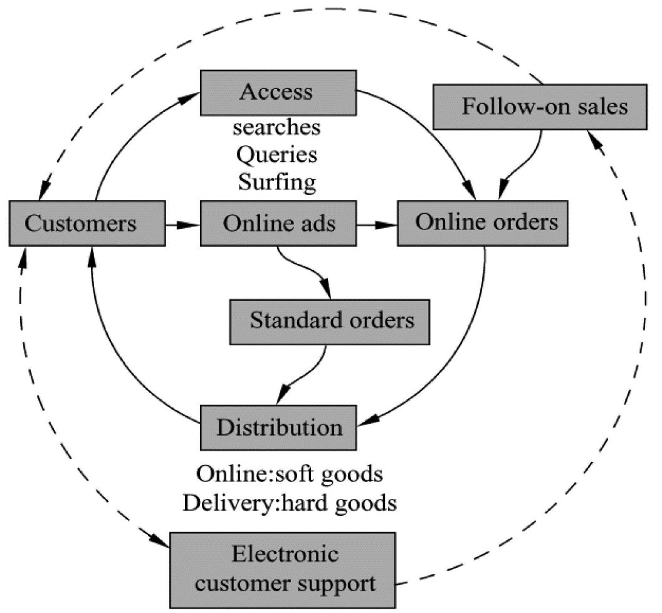
Figure 4-6 Cycle of electronic commerce

Slide 61
2. E-Commerce Business Models
A company’s policies, operations, and technology define its business model.
In essence, a company’s business model describes how the company generates revenue.
There are a number of standard e-commerce business models, including business to consumer (B2C), business to business (B2B), consumer to consumer (C2C), and business to government (B2G).
Some of the most commonly used models are discussed next.

Slide 62
（1）Business to Consumer (B2C)
With the business-to-consumer (B2C) model, businesses sell goods or services to individual consumers.
The B2C model was one of the first major types of e-commerce business models to be defined and implemented using the Web.
Some examples of B2C businesses include Amazon.com, L.L. Bean, Walmart.com, and Polo.com (see Figure 4-7).
These businesses can be Internet-only stores, or click-and-mortar stores with both online and traditional storefronts.

Slide 63
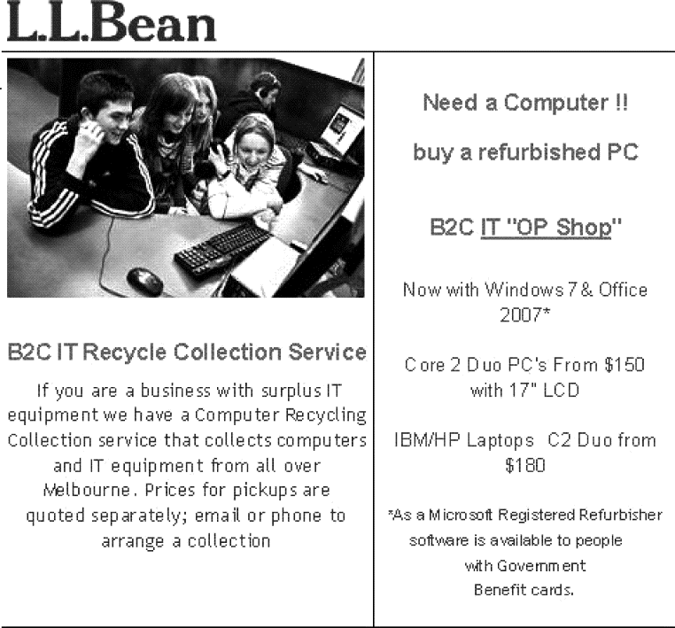
Figure 4-7 Business to consumer

Slide 64
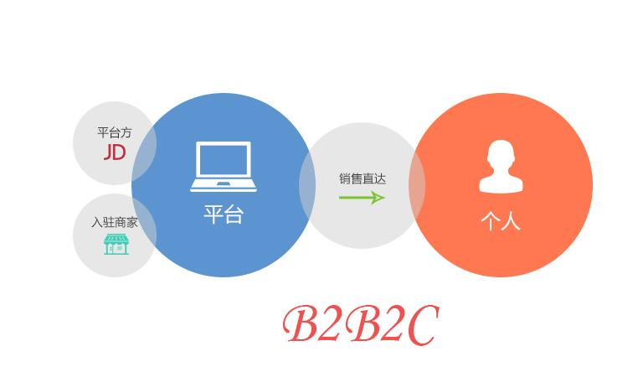
From the Internet

Slide 65
（2）Business to Business (B2B)
Business-to-business (B2B) applications include any type of e-commerce transaction taking place between two businesses.
B2B revenue is increasing and expected to continue to grow tremendously in the next few years.

Slide 66
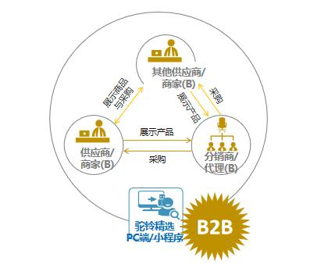
From the Internet

Slide 67
（3）Consumer to Consumer (C2C)
The consumer-to-consumer (C2C)—sometimes referred to as the person-to-person or P2P—business model almost solely consists of consumer auctions, where consumers sell products to other consumers.
With millions of products for sale every day, eBay is one of the largest C2C e-commerce business today.

Slide 68
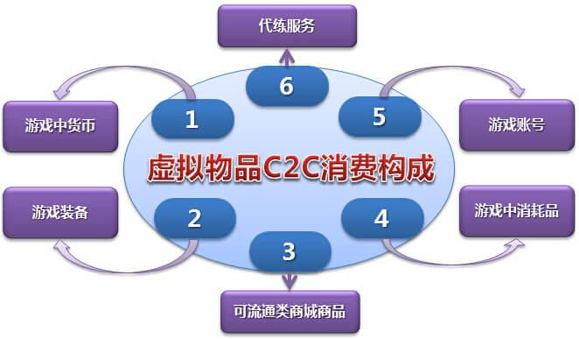
From the Internet

Slide 69
（4）Business to Government (B2G)
With U.S. government spending exceeding $500 billion per year with no signs of slowing down, business-to-government (B2G) organizations are becoming more prominent.
These organizations sell products and services to local, state, and federal government buyers.
In general, the government sector has been slower to embrace online buying than the private sector.

Slide 70
Related B2G activities include some states allowing citizens to make payments online, such as paying taxes, renewing driver’s licenses, and so forth.
This is sometimes referred to as C2G or customer-to-government e-commerce.

Slide 71
4.3 ELECTRONIC COMMERCE AND THE INTERNET OF THINGS 4.3.2 INTERNET OF THINGS

Slide 72
KEYWORDS
Internet of Things (IoT) 物联网
object 目标，对象，客体
embedded 嵌入（式）的
sensor 传感器
connectivity 连通性，连通度
identifiable可辨识的，可视为同一的，可确认身份的
interoperate （相）互操作
infrastructure 基础设施，基础结构

Slide 73
M2M (Machine-to-Machine) 机器对（到）机器
protocol 协议
domain 域，定义域，范畴
interconnection 互连，互接
biochip 生物芯片
transponder 发射应答机，转发器，询问机
thermostat 自动调温器
aggregate 集合，聚集，集合的，合计的
event-driven 事件驱动

Slide 74
RFID (Radio Frequency Identification)
射频识别，无线射频识别
GPS navigator 全球定位导航器
backbone 主干，骨干
syntactic 句法的
SOA (Service Oriented Architecture)
面向服务的体系结构
decision-making system 决策支持系统
avatar 具体化，具体表现，阿凡达
self-reference 自参考，自引用
wearable computing 可穿戴计算技术
ecosystem 生态系统

Slide 75
1. Overview of The Internet of Things
The Internet of Things (IoT) is the network of physical objects or “things” embedded with electronics, software, sensors and connectivity to enable it to achieve greater value and service by exchanging data with the manufacturer, operator and/or other connected devices.

Slide 76
Each thing is uniquely identifiable through its embedded computing system but is able to interoperate within the existing Internet infrastructure.

Slide 77
Typically, IoT is expected to offer advanced connectivity of devices, systems, and services that goes beyond machine-to-machine communications (M2M) and covers a variety of protocols, domains, and applications.
The interconnection of these embedded devices (including smart objects), is expected to usher in automation in nearly all fields, while also enabling advanced applications like a Smart Grid.

Slide 78
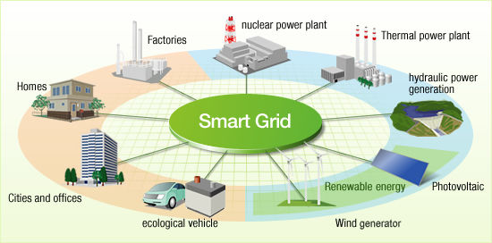
From the Internet

Slide 79
Things, in the IoT, can refer to a wide variety of devices such as heart monitoring implants, biochip transponders on farm animals, electric clams in coastal waters, automobiles with built-in sensors, or field operation devices that assist fire-fighters in search and rescue.

Slide 80
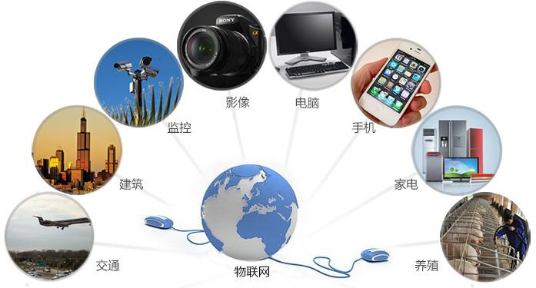
From the Internet

Slide 81
These devices collect useful data with the help of various existing technologies and then autonomously flow the data between other devices.
Current market examples include smart thermostat systems and washer/dryers that utilize wifi for remote monitoring.

Slide 82
Besides the plethora of new application areas for Internet connected automation to expand into, IoT is also expected to generate large amounts of data from diverse locations that is aggregated at a very high-velocity, thereby increasing the need to better index, store and process such data.

Slide 83
2. Architecture of The Internet of Things
The IoT system is likely to have an event-driven architecture.
In Figure 4-8, IoT development is shown with a three-layer architecture.
The top layer is formed by driven applications.
The application space of the IoT is huge.

Slide 84
The bottom layers represent various types of sensing devices: namely RFID tags, ZigBee or other types of sensors, and road-mapping GPS navigators.
Signals or information collected at these sensing devices are linked to the applications through the could computing platform at the middle layer.

Slide 85
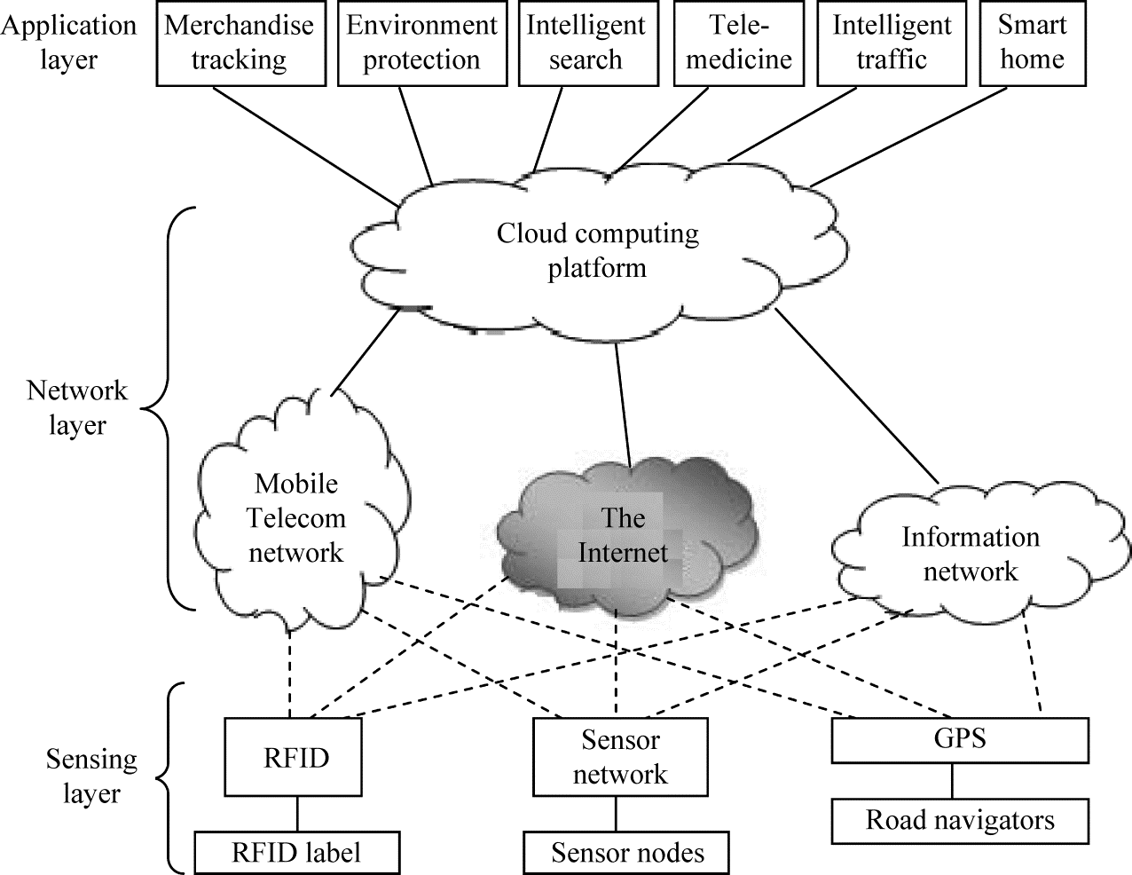
Figure 4-8 The architecture of an IoT consisting of sensing devices that are connected to various applications via mobile networks, the Internet, and processing clouds.

Slide 86
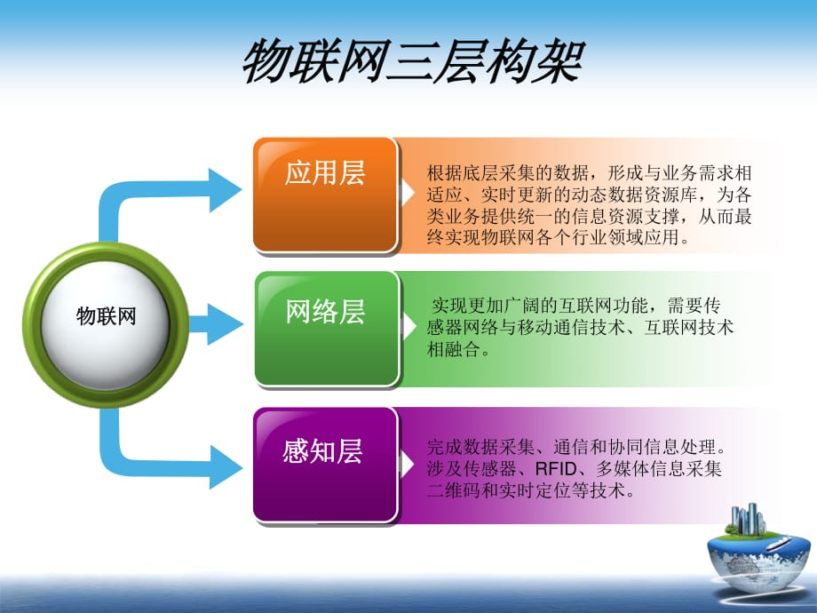
From the Internet

Slide 87
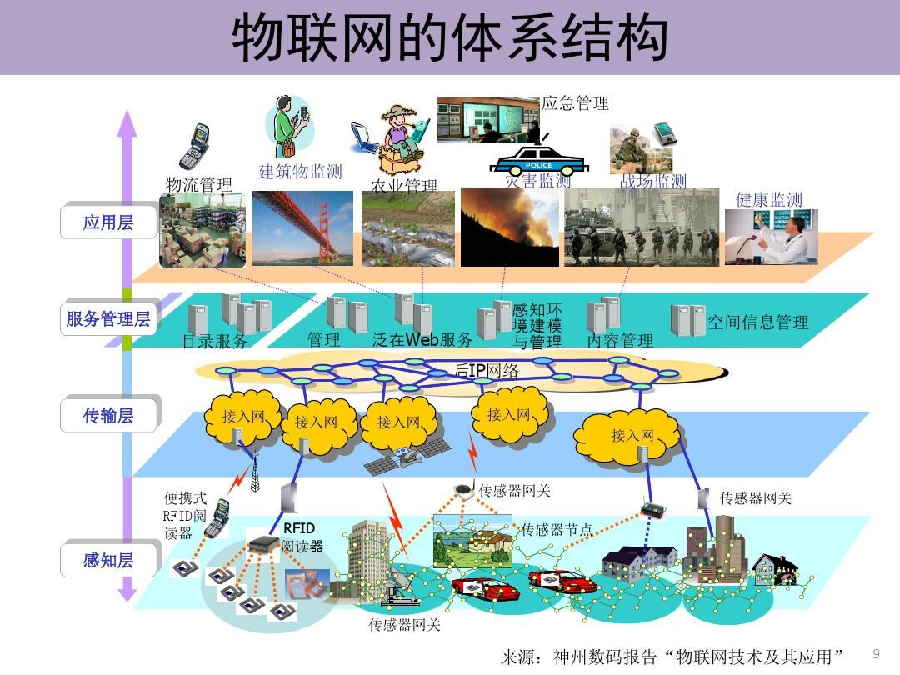
From the Internet

Slide 88
The signal processing clouds are built over the mobile networks, the Internet backbone, and various information networks at the middle layer.
In the IoT, the meaning of a sensing event does not follow a deterministic or syntactic model.
In fact, the service-oriented architecture (SOA) model is adoptable here.
A large number of sensors and filters are used to collect the raw data.

Slide 89
Various compute and storage clouds and grids are used to process the data and transform it into information and knowledge formats.
The sensed information is used to put together a decision-making system for intelligence applications.
The middle layer is also considered as a Semantic Web.
Some actors (service, components, avatars) are self- referenced.

Slide 90
3. Applications
According to Gartner, Inc. (a technology research and advisory corporation), there will be nearly 26 billion devices on the Internet of Things by 2020.
ABI Research estimates that more than 30 billion devices will be wirelessly connected to the Internet of Things (Internet of Everything) by 2020.

Slide 91
As per a recent survey and study done by Pew Research Internet Project, a large majority of the technology experts and engaged Internet users who responded—83 percent—agreed with the notion that the Internet/Cloud of Things, embedded and wearable computing (and the corresponding dynamic systems) will have widespread and beneficial effects by 2025.
It is, as such, clear that the IoT will consist of a very large number of devices being connected to the Internet.

Slide 92
The ability to network embedded devices with limited CPU, memory and power resources means that IoT finds applications in nearly every field.
Such systems could be in charge of collecting information in settings ranging from natural ecosystems to buildings and factories, thereby finding applications in fields of environmental sensing and urban planning.

Slide 93
On the other hand, IoT systems could also be responsible for performing actions, not just sensing things.
Intelligent shopping systems, for example, could monitor specific users’ purchasing habits in a store by tracking their specific mobile phones.

Slide 94
These users could then be provided with special offers on their favorite products, or even location of items that they need.
Additional examples of sensing and actuating are reflected in applications that deal with heat, electricity and energy management, as well as cruise-assisting transportation systems.

Slide 95
However, the application of the IoT is not only restricted to these areas.
Other specialized use cases of the IoT may also exist.
An overview of some of the most prominent application areas is provided here.

Slide 96
Based on the application domain, IoT products can be classified broadly into five different categories: smart wearable, smart home, smart city, smart environment, and smart enterprise.
The IoT products and solutions in each of these markets have different characteristics.

Slide 97
The End of this Section

